Slide 1
So I hear you’d like to do some ranked coding…
Introduction to Competitive Programming

Slide 2
Workshop Agenda
Who is KCPC?
What does KCPC do?
Why start KCPC?
What is Competitive Programming?
Why do Competitive Programming?
Some nice problems
Final messages

Slide 3
But first attendance…

Slide 4

Attendance

Slide 5
Who is KCPC

Slide 6
Who is KCPC
King’s Competitive Programming Club:
President: Matthew

Slide 7
Who is KCPC
King’s Competitive Programming Club:
President: Matthew
Vice President: Kutay

Slide 8
Who is KCPC
King’s Competitive Programming Club:
President: Matthew
Vice President: Kutay
General Secretary and Treasurer: Annoor (Beed)

Slide 9
Who is KCPC
King’s Competitive Programming Club:
President: Matthew
Vice President: Kutay
General Secretary and Treasurer: Annoor (Beed)
Competitive Programmes: Marcell

Slide 10
Who is KCPC
King’s Competitive Programming Club:
President: Matthew
Vice President: Kutay
General Secretary and Treasurer: Annoor (Beed)
Competitive Programmes: Marcell
In collaboration with KCL Tech!

Slide 11
Who is KCPC
King’s Competitive Programming Club:
President: Matthew
Vice President: Kutay
General Secretary and Treasurer: Annoor (Beed)
Competitive Programmes: Marcell
In collaboration with KCL Tech!
Partnered with Orthant Research Group under the Orthant Research Europe division

Slide 12
Why start KCPC?

Slide 13
Why start King’s Competitive Programming Club?
Create a central hub for algorithmic training in London

Slide 14
Why start King’s Competitive Programming Club?
Create a central hub for algorithmic training in London
Provide structured, high-quality training

Slide 15
Why start King’s Competitive Programming Club?
Create a central hub for algorithmic training in London
Provide structured, high-quality training
Replace isolated practise with community learning

Slide 16
Why start King’s Competitive Programming Club?
Create a central hub for algorithmic training in London
Provide structured, high-quality training
Replace isolated practise with community learning
Develop elite algorithmic thinkers

Slide 17
Why start King’s Competitive Programming Club?
Create a central hub for algorithmic training in London
Provide structured, high-quality training
Replace isolated practise with community learning
Develop elite algorithmic thinkers
Connect students to top-tier opportunities

Slide 18
Why start King’s Competitive Programming Club?
Create a central hub for algorithmic training in London
Provide structured, high-quality training
Replace isolated practise with community learning
Develop elite algorithmic thinkers
Connect students to top-tier opportunities
Treat competitive programming as a serious discipline

Slide 19
Why start King’s Competitive Programming Club?
Create a central hub for algorithmic training in London
Provide structured, high-quality training
Replace isolated practise with community learning
Develop elite algorithmic thinkers
Connect students to top-tier opportunities
Treat competitive programming as a serious discipline
Build a cross-University collaborative network

Slide 20
What does KCPC do?

Slide 21
What does KCPC do?
Run weekly training sessions

Slide 22
What does KCPC do?
Run weekly training sessions
Teach algorithm and data structures

Slide 23
What does KCPC do?
Run weekly training sessions
Teach algorithm and data structures
Host competitive programming contests

Slide 24
What does KCPC do?
Run weekly training sessions
Teach algorithm and data structures
Host competitive programming contests
Train competition teams

Slide 25
What does KCPC do?
Run weekly training sessions
Teach algorithm and data structures
Host competitive programming contests
Train competition teams
Provide mentoring and coaching

Slide 26
What does KCPC do?
Run weekly training sessions
Teach algorithm and data structures
Host competitive programming contests
Train competition teams
Provide mentoring and coaching
Support all skill levels

Slide 27
What does KCPC do?
Run weekly training sessions
Teach algorithm and data structures
Host competitive programming contests
Train competition teams
Provide mentoring and coaching
Support all skill levels
Maintain an active collaborative community

Slide 28
What is Competitive Programming?

Slide 29
What is Competitive Programming?
A sport focused on solving challenging problems

Slide 30
What is Competitive Programming?
A sport focused on solving challenging problems
Problems are solved via correct and efficient algorithms

Slide 31
What is Competitive Programming?
A sport focused on solving challenging problems
Problems are solved via correct and efficient algorithms
Must adhere to constraints to score points

Slide 32
What is Competitive Programming?
A sport focused on solving challenging problems
Problems are solved via correct and efficient algorithms
Must adhere to constraints to score points
Requires both designing and implementing algorithms

Slide 33
What is Competitive Programming?
A sport focused on solving challenging problems
Problems are solved via correct and efficient algorithms
Must adhere to constraints to score points
Requires both designing and implementing algorithms
Timed competitions are held online or at LAN events

Slide 34
What is Competitive Programming?
A sport focused on solving challenging problems
Problems are solved via correct and efficient algorithms
Must adhere to constraints to score points
Requires both designing and implementing algorithms
Timed competitions are held online or at LAN events
Solutions are judged automatically on submission

Slide 35
What is Competitive Programming?
A sport focused on solving challenging problems
Problems are solved via correct and efficient algorithms
Must adhere to constraints to score points
Requires both designing and implementing algorithms
Timed competitions are held online or at LAN events
Solutions are judged automatically on submission
Competitions are timed

Slide 36
What is a correct and efficient algorithm?

Slide 37
What is a correct and efficient algorithm?
Sound: For all solutions given by an algorithm is indeed correct

Slide 38
What is a correct and efficient algorithm?
Sound: For all solutions given by an algorithm is indeed correct
Complete: An algorithm finds a solution when one exist

Slide 39
What is a correct and efficient algorithm?
Sound: For all solutions given by an algorithm is indeed correct
Complete: An algorithm finds a solution when one exist
Fast: An algorithm terminates within the allotted time

Slide 40
What is a correct and efficient algorithm?
Sound: For all solutions given by an algorithm is indeed correct
Complete: An algorithm finds a solution when one exist
Fast: An algorithm terminates within the allotted time
Small: An algorithm only uses the memory allowed

Slide 41
What is a correct and efficient algorithm?
Sound: For all solutions given by an algorithm is indeed correct
Complete: An algorithm finds a solution when one exist
Fast: An algorithm terminates within the allotted time
Small: An algorithm only uses the memory allowed
Making algorithms sound and complete are relatively easy once you understand the problem

Slide 42
What is a correct and efficient algorithm?
Sound: For all solutions given by an algorithm is indeed correct
Complete: An algorithm finds a solution when one exist
Fast: An algorithm terminates within the allotted time
Small: An algorithm only uses the memory allowed
Making algorithms sound and complete are relatively easy once you understand the problem
But creating them to be fast and small is where most of the challenges lie.

Slide 43
Requirements for designing algorithms

Slide 44
Requirements for designing algorithms
Strong foundations in mathematics
Notes:
For the time being a GCSE/High School level of maths is more than enough for competitive programming

Slide 45
Requirements for designing algorithms
Strong foundations in mathematics
Algorithmic analysis
Notes:
For the time being a GCSE/High School level of maths is more than enough for competitive programming

Slide 46
Requirements for designing algorithms
Strong foundations in mathematics
Algorithmic analysis
Knowledge of algorithm theory
Notes:
For the time being a GCSE/High School level of maths is more than enough for competitive programming

Slide 47
Requirements for designing algorithms
Strong foundations in mathematics
Algorithmic analysis
Knowledge of algorithm theory
Ability to use well-known techniques
Notes:
For the time being a GCSE/High School level of maths is more than enough for competitive programming

Slide 48
Requirements for designing algorithms
Strong foundations in mathematics
Algorithmic analysis
Knowledge of algorithm theory
Ability to use well-known techniques
Creativity to develop new insights and ideas
Notes:
For the time being a GCSE/High School level of maths is more than enough for competitive programming

Slide 49
Requirements for designing algorithms
Strong foundations in mathematics
Algorithmic analysis
Knowledge of algorithm theory
Ability to use well-known techniques
Creativity to develop new insights and ideas
Awareness of how algorithms related to scientific research
Notes:
For the time being a GCSE/High School level of maths is more than enough for competitive programming

Slide 50
Requirements for designing algorithms
Strong foundations in mathematics
Algorithmic analysis
Knowledge of algorithm theory
Ability to use well-known techniques
Creativity to develop new insights and ideas
Awareness of how algorithms related to scientific research
Don’t worry if this seems too much, you only need GCSE level mathematics to get started!
Notes:
For the time being a GCSE/High School level of maths is more than enough for competitive programming

Slide 51
Requirements for implementing algorithms

Slide 52
Requirements for implementing algorithms
Good algorithm design

Slide 53
Requirements for implementing algorithms
Good algorithm design
Strong programming skills: C++, Python, Java

Slide 54
Requirements for implementing algorithms
Good algorithm design
Strong programming skills: C++, Python, Java
Ability to translate ideas into correct code

Slide 55
Requirements for implementing algorithms
Good algorithm design
Strong programming skills: C++, Python, Java
Ability to translate ideas into correct code
Attention to detail in handling test cases

Slide 56
Requirements for implementing algorithms
Good algorithm design
Strong programming skills: C++, Python, Java
Ability to translate ideas into correct code
Attention to detail in handling test cases
You won’t need to make the code maintainable like in software engineering.

Slide 57
Requirements for implementing algorithms
Good algorithm design
Strong programming skills: C++, Python, Java
Ability to translate ideas into correct code
Attention to detail in handling test cases
You won’t need to make the code maintainable like in software engineering.
But most solutions are at most a few hundred lines of codes anywhere so making your solution concise and straightforward.

Slide 58
Example of a Competitive Programming problem

Slide 59
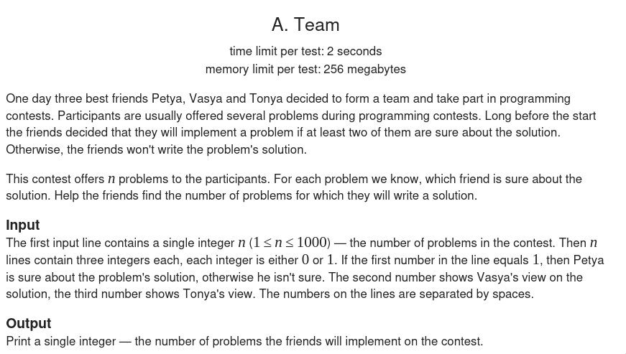
Ex: Problem description
https://codeforces.com/problemset/problem/231/A

Slide 60
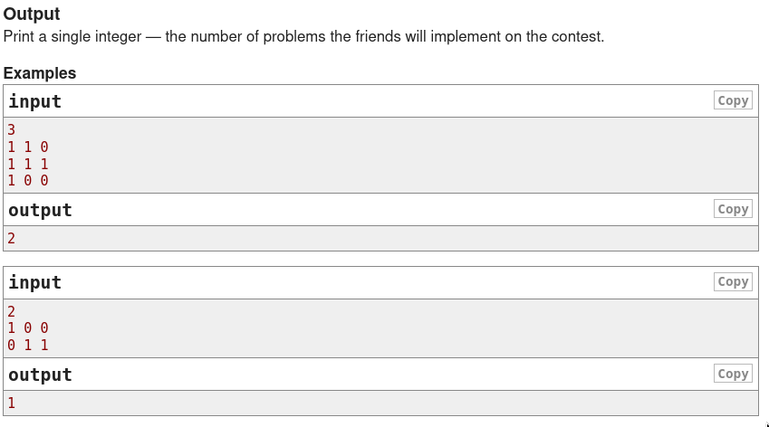
Ex: Input and Output
https://codeforces.com/problemset/problem/231/A

Slide 61
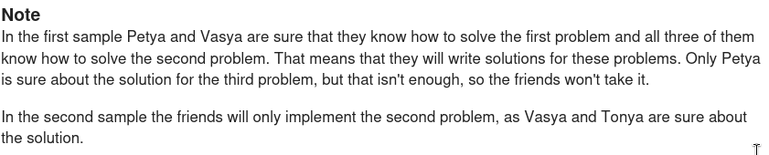
Ex: Problem notes
https://codeforces.com/problemset/problem/231/A

Slide 62
Why do Competitive Programming?

Slide 63
Why do Competitive Programming?
Sharpens your problem-solving skills

Slide 64
Why do Competitive Programming?
Sharpens your problem-solving skills
Improves coding accuracy and speed

Slide 65
Why do Competitive Programming?
Sharpens your problem-solving skills
Improves coding accuracy and speed
Many companies value competitive programming experience

Slide 66
Why do Competitive Programming?
Sharpens your problem-solving skills
Improves coding accuracy and speed
Many companies value competitive programming experience
Deepens understanding of algorithms and data structures

Slide 67
Why do Competitive Programming?
Sharpens your problem-solving skills
Improves coding accuracy and speed
Many companies value competitive programming experience
Deepens understanding of algorithms and data structures
It’s fun

Slide 68
Some nice problems

Slide 69
Some nice problems
tinyurl.com/kcpcws

Slide 70
Some nice problems
tinyurl.com/kcpcws
kcpc.orthant.co.uk/r/0b464d30-8c8a-4ebe-8270-7c0d868c83c1

Slide 71
Final messages

Slide 72
Final messages
Too easy today? Harder challenges are coming

Slide 73
Final messages
Too easy today? Harder challenges are coming
Too hard today? That means you’re learning and that's great!

Slide 74
Final messages
Too easy today? Harder challenges are coming
Too hard today? That means you’re learning and that's great!
Either way, you belong here: Our goal is simple: be better than yesterday

Slide 75
Final messages
Too easy today? Harder challenges are coming
Too hard today? That means you’re learning and that's great!
Either way, you belong here: Our goal is simple: be better than yesterday
See you next week at the same time!

